Slide 1
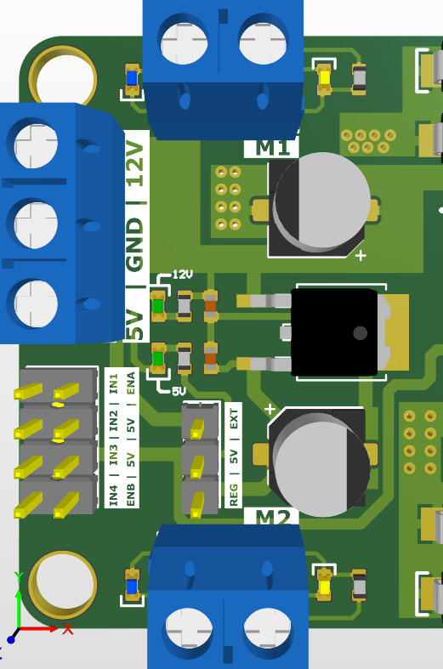
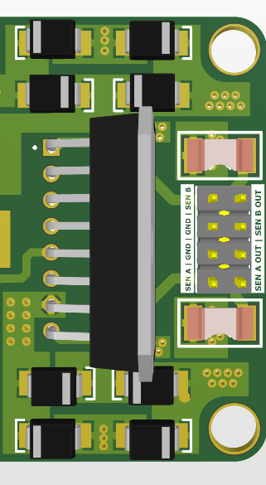
L298N Dual H-Bridge Motor Driver
Configuration A
With current sense resistors
Sense A
GND
LED Blue : Motor 1 Direction
LED Yellow : Motor 1 Direction
Sense B
GND
In this configuration, the load current will directly travels from the Sense A pin and the Sense B of the L298N to the GND, Bypassing the current sense resistor.
LED Indication: 12V Rail
Configuration B
Sense A
LED Indication: 5V Rail
GND
Current Resistor A Out
Sense B
Current Resistor B Out
0~1v Current Sense
Signal Out
GND
In this configuration, the load current will travels from the Sense A pin and the Sense B of the L298N through the current sense resistors.
LED Blue : Motor 2 Direction
LED Yellow : Motor 2 Direction
= Normal Pin
= Jumper installed

